Slide 1
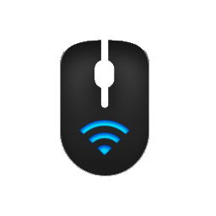
PCRemote
WP7 Client overview

Slide 2
General idea
Project consists of two applications:
1. PCRemote Server running on computer you want to control.
2. PCRemote Client running on Windows Phone device.
Project allows to take the control over the cursor and the keyboard of a computer with a WP7 device.
Server and client communicate via Wi-Fi.

